Slide 1

Maps in PowerBI
PELAGIA T MUYAMBIRI

Slide 2
Table of contents
01
02
03
What are maps?
Importance of maps
How to make a map in powerbi

Slide 3
Maps
A map is a graphical representation of a region, usually displaying geographical elements like landmarks, roads and cities
(Oxford University Press, 2022)

Slide 4
Maps
In Data Analysis they are important because they allow analysts to visualize and understand geographical patterns and trends. This helps in making informed decisions, identifying areas of interest and also optimizing resource allocation.

Slide 5
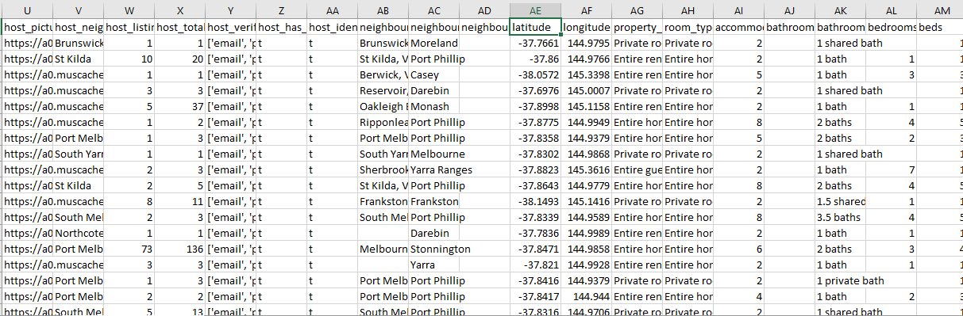
Maps in Powerbi

Slide 6
Maps in PowerBI
QUESTION
Geographical Insights:
Visualize the distribution of listings on a map to identify popular neighborhoods.

Slide 7
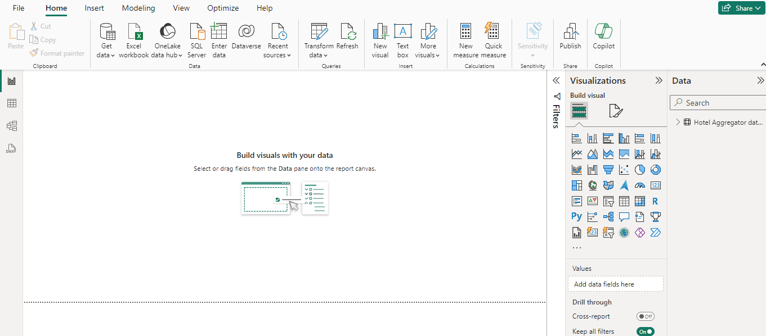

Maps in PowerBI

Slide 8
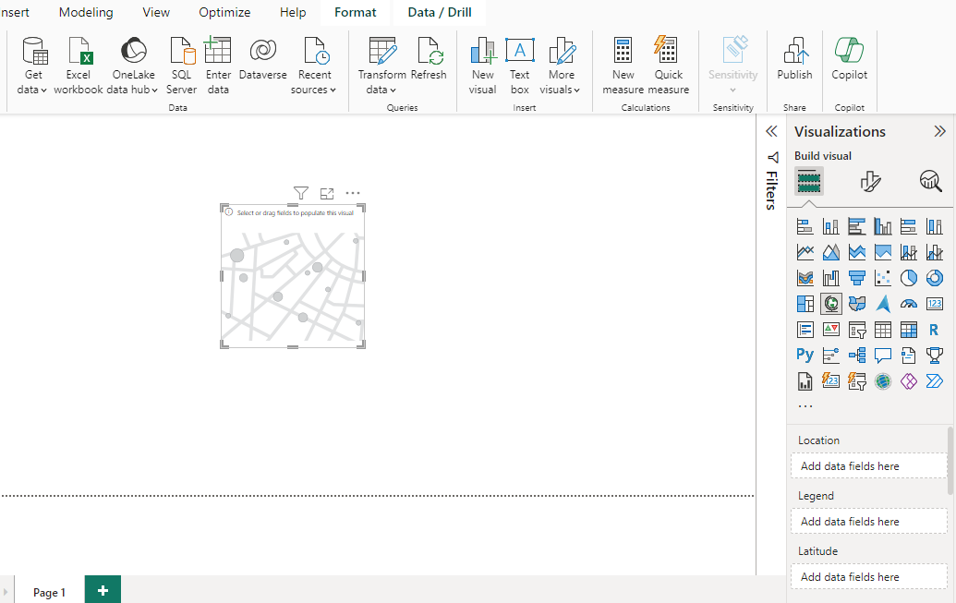

Maps in PowerBI
QUESTION
Geographical Insights:
Visualize the distribution of listings on a map to identify popular neighborhoods.

Slide 9
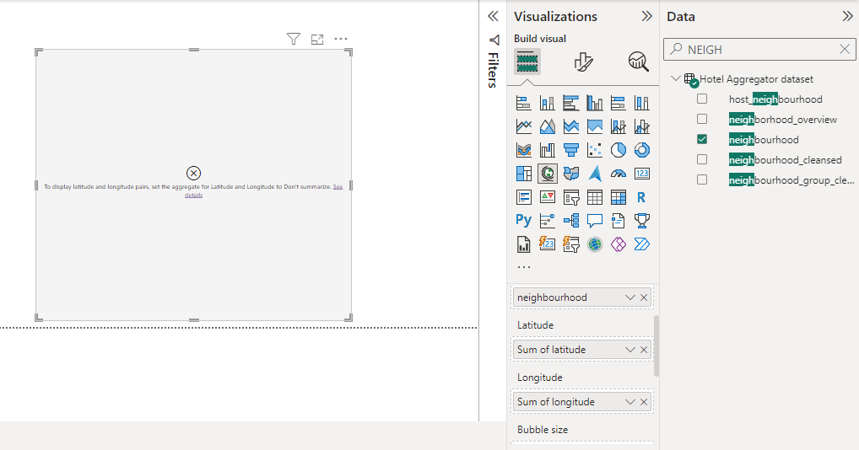

Maps in PowerBI
QUESTION
Geographical Insights:
Visualize the distribution of listings on a map to identify popular neighborhoods.

Slide 10
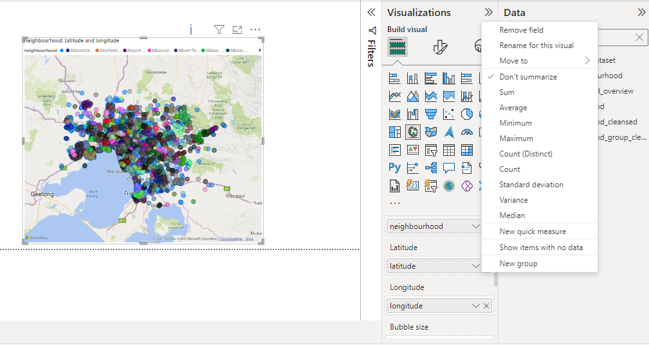

Maps in PowerBI
QUESTION
Geographical Insights:
Visualize the distribution of listings on a map to identify popular neighborhoods.

Slide 11
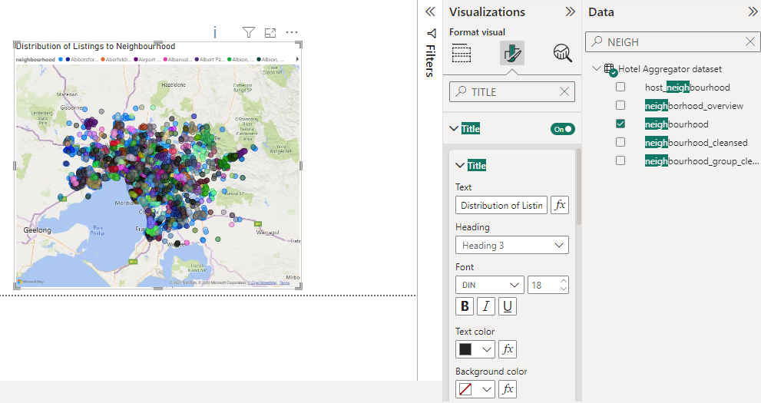

Maps in PowerBI
QUESTION
Geographical Insights:
Visualize the distribution of listings on a map to identify popular neighborhoods.

Slide 12
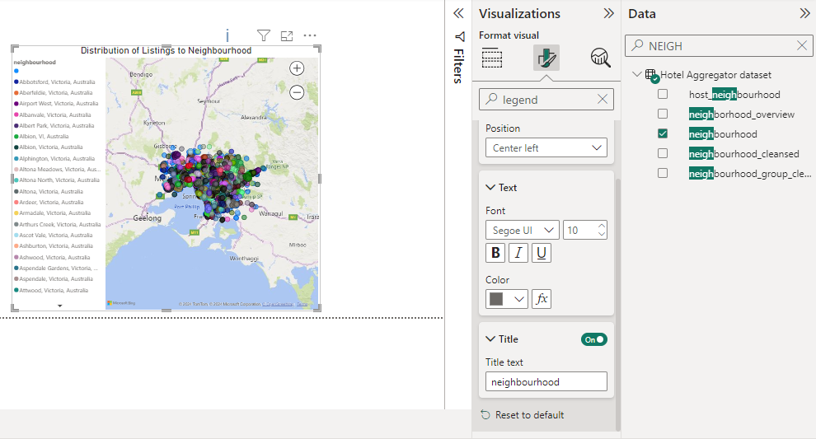

Maps in PowerBI
QUESTION
Geographical Insights:
Visualize the distribution of listings on a map to identify popular neighborhoods.

Slide 13
THANK YOU

